Slide 1

All Coach safety Meeting
January 14th 2026
Welcome
Expectations
Website
Rules
Scheduling
Safety & First Aid
President’s Message
Questions

Slide 2


Manager/Coach Expectations
High Desert Little League
Be a Leader
Conduct yourself in a manner that sets a good example – even if others are not
Have a plan for every practice and every game
https://www.littleleague.org/university/coaches/
USA Baseball Mobile Coach App
practice plans
drills
pitching tips
All coaches (including practice coaches) must have cleared background AND completed Abuse Awareness training PRIOR to participating in team activities
Notes:
Be A Leader
first to arrive; last to leave --- PLEASE make sure all your players leave with their rides… don’t leave anyone before you leave.
Ensure all assistants have cleared background and do not let them coach or participate in practices until they are cleared. We trust you to enforce this. The process is online and everyone who has registered to volunteer will received an email with an individualized link to complete the background questionnaire.
Complaints:, As the Team Manager be publicly supportive of our league. If you have a complaint or frustration please contact me or the league president. Do not complain to parents, assistants or the kids.

Slide 3
Manager/Coach Expectations
High Desert Little League
Play By The Rules
Do NOT modify the game in any way
Do NOT ask another coach to modify the game
Know the rules – read the book!
Understand the by-laws
Raise The Bar
Coach to the level of your strongest player
Expect more; praise often
Use your resources
Notes:
Play By The Rules
do NOT modify the game in any way
do NOT ask another coach to modify the game
know the rules – read the book!
understand the by-laws -- - (a copy of the approved by-laws will be in your coaches packet)
Raise The Bar
coach to the level of your strongest player
expect more
praise often

Slide 4
Manager/Coach Expectations
High Desert Little League
Let us be your advocate
You are a volunteer
You will make mistakes
We don’t expect perfection
Let us help you
Deal with parents
Deal with other managers/coaches
Deal with umpires
Deal with player issues
Don’t hesitate to contact us
Lia Morton 602.769.0527
mc@highdesertlittleleague.com

Slide 5
Important Dates
February 27th & 28th – Opening Days
February 28th – Picture Day/Raffle Drawing
March 4th – Makeup Pictures
End of April – All-Star Manager and Coach Selection
May 9th – Regular Season Ends
May 11-15th – Spring tournament
May 16th – All-Star Nominations and Tryouts

Slide 6
Communications
High Desert Little League
Website – www.highdesertlittleleague.com Hosted by Sports Connect & Partnered with Dick's Sporting Goods
Team Pages- Game Changer *** Roster * Schedule * Input Scores/ Pitch Counts * Email ***
Practice/Game Cancellation Notifications
Weather – website, email, social media (FaceBook and Twitter)
By the Manager – EMAIL OR CALL ASAP * Anthem charges us if within 72 hours – note new cancellation policy in folder
Email scheduling@highdesertlittleleague.com
League Communications
Social Media (FaceBook & Twitter)
Emails
Tim May | Information Director info@highdesertlittleleague.com

Slide 7
Know the Rules!
Little League International
https://www.littleleague.org/playing-rules/rules-regulations-policies/
LL Rulebook App – download for FREE
App Store / Google Play
Automatically updated
Local Rules/By-laws (QRG)
Manager folder
Concessions
Website

Slide 8
Know the Rules!
Bat the entire lineup (Except BB Seniors)
9 players in the field (Tee-Ball all in field)
Safety Bases
Machine Pitch – 7 Pitches (NO WALKS)
Home team reports scores/pitch count (BB Minors AA, AAA and Majors – pitch count)
No leading off
AA/ AAA- all players sit once prior to any player sitting twice
*NEW* AA - No Stealing Home
SB Minors - Coach Assist after 4 pitches
NO on-deck batters (except BB Seniors)
NO Bat Flips – Immediate expulsion from game
Catchers must wear "dangling" throat protector – Rule 1.17

Slide 9
Pitching
Maximum Number of Pitches per Game
League Age 8: 50
League Age 9/10: 75
League Age 11/12: 85
League Age 13-16: 95
Intentional Walks – Defensive Manager must notify umpire of intentional walk. Remaining "balls" to achieve the walk are added to pitch count.
Pitcher may NOT catch if threw 41 or more pitches
Catcher may NOT pitch if caught 4 or more innings
Notes:
Divisions: Minor and Major Baseball Divisions
Allows a defensive team to intentionally walk a batter in Minor and Major Divisions. (Page 97).
Summary:
Prior to a pitch being thrown, the defense elects to “Intentionally Walk” the batter by announcing such decision to the plate umpire.
NOTE 1: Such notification must be made by the defensive manager. The manager must request and be granted “time” by the umpire and then inform the umpire of the defense’s intent to walk the batter.
NOTE 2: The ball is dead and no other runners may advance unless forced by the batter’s award. Four (4) pitches will be added to the pitch count.

Slide 10
Pitching
Required Rest (AA, AAA, Majors)
66 or more = 4 calendar days
51-65 = 3 calendar days
36-50 = 2 calendar days
21-35 = 1 calendar days
0-20 = 0 days of rest
Required Rest (Juniors)
76 or more = 4 calendar days
61-75 = 3 calendar days
46-60 = 2 calendar days
31-45 = 1 calendar days
0-30 = 0 days of rest
Calendar days DO NOT equal 24 hours
Example - AA Player pitches 42 on Monday. Player rests Tuesday AND Wednesday. Player can pitch again on Thursday.

Slide 11
Required Reporting
High Desert Little League
Reporting Official Game Scores and Pitch Count – within 24 hours
Home Team Responsibilities
Report Total Pitch Count for ALL Pitchers (Home and Visitor)
Report Pitchers First and Last Name
Report Final Score
Visiting Team Responsibilities
Confirm Total Pitch Count for ALL Pitchers with Home Team
Confirm Pitchers First and Last Name with Home Team
Confirm Final Score with Home Team
Notes:
MATT or Seth Chime in?

Slide 12
Scheduling
High Desert Little League
Games on Opening Day, February 27th and 28th
Regular season ends May 9th
Umpire issues
Please report those to umpires@highdesertlittleleague.com
Provide the issue, division, game time and field information

Slide 13
Uniforms, Pictures, Awards
High Desert Little League
Uniforms
Must show ALL medical forms
Tentative Pickup Feb. 9th – 13th
Pictures – Feb 28th and Makeups March 4th
Raffle Tickets / Drawing
Ticket turn-in by Feb 27th , 5-7 pm
Prize Drawing – Feb 28th at 3 pm
Trophies – T-Ball
Pins – Machine Pitch through Juniors
Rings – player pitch tournament winners
Notes:
Chris Parrish – Uniform Manger
Seth Burnett – Information Director --- picture packets
Raffle tickets are on order, and will be ready prior to the beginning of practices on Sat Feb 4th. We will get these distributed so the Managers can hand them out at their first practices.

Slide 14
Safety & First Aid
Bleeding
Bruising & Swelling
Heat
Concussion
Seizures
Broken Bones
Bat Safety
Online Reporting
Forms on Website
https://form.jotform.us/form/33164807965160
24 hr window
Stephanie Venezia
HDLL Safety Officer/Equipment Coordinator
safe-equip@highdesertlittleleague.com
805.766.4256

Slide 15

Concussion Fact Sheet

Slide 16
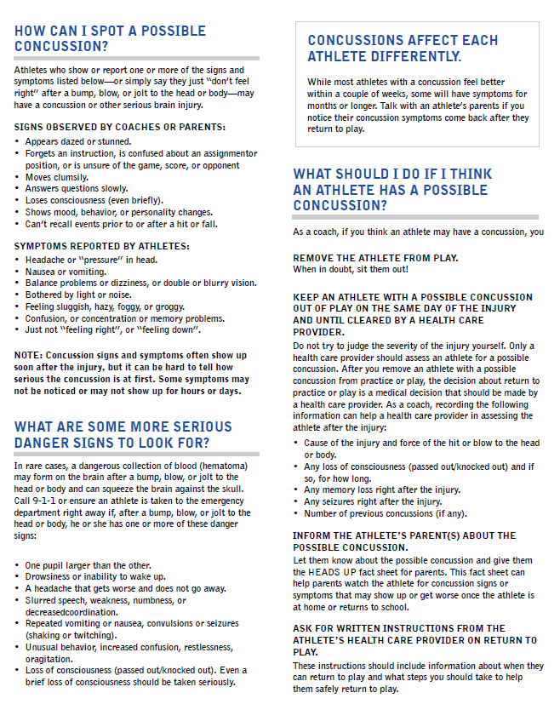
Concussion Fact Sheet (cont'd)

Slide 17
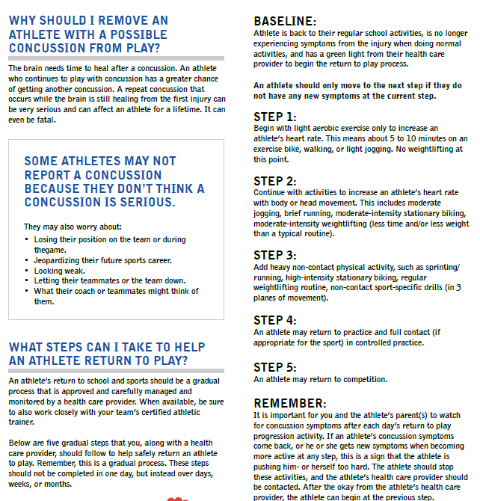
Concussion Protocol (cont'd)

Slide 18
Board of Directors
President* | Tara Krantz | president@highdesertlittleleague.com
Vice President* | Hannah Beer | vp@highdesertlittleleague.com
Treasurer* | Ben Grindel | treasurer@highdesertlittleleague.com
Secretary* | Adam O’Halloran | secretary@highdesertlittleleague.com
Player Agent* | Adam Raley | playeragent@highdesertlittleleleague.com
Softball Director | Jentri Young | softball@highdesertlittleleague.com
Safety Officer/Equip | Stephanie Venezia | safe-equip@highdesertlittleleague.com
Information Director | Tim May | info@highdesertlittleleague.com
Manager Coordinator | Lia Morton | mc@highdesertlittleleague.com
Scheduling Coordinator | Dawnee Hunt | scheduling@highdesertlittleleleague.com
Fundraising/Sponsorship/Events | Amity Jokerst | fundraising@highdesertlittleleague.com
Concessions Coordinator | Kristin Patrick | concessions@highdesertlittleleague.com
Uniforms Coordinator | Megan Fay | uniforms@highdesertlittleleague.com
Umpire Coordinator | Kyle Kuhn | umpires@highdesertlittleleague.com

Slide 19
President’s Message & Thank you
High Desert Little League
You are the backbone of our League.
You have the most impact on our young players.
Thank you for serving as a role model.
Tara Krantz, President
president@highdesertlittleleague.com

Slide 20

Q & A
High Desert Little League
www.highdesertlittleleague.com • info@highdesertlittleleague.com
Serving the communities of Anthem, Tramonto, Desert Hills, New River, and Sonoran Foothills

